Slide 1


SMART INDIA HACKATHON 2024
TITLE PAGE
Problem Statement ID – SIH1610
Problem Statement Title- Learning App for Deaf And Mute and sign language- English/Gujarati converter
Theme- Smart Education
PS Category- Software
Team ID- SIH04
Team Name- Beta Squad

Slide 2
IDEA TITLE
Beta Squad
Beta
Squad
Proposed Solution (Describe your Idea/Solution/Prototype)
We designed a learning App for Deaf and Mute to providing a comprehensive platform for learning .
Its meets the needs of Deaf and Mute Students With Personalized
Learning Path.

Slide 3
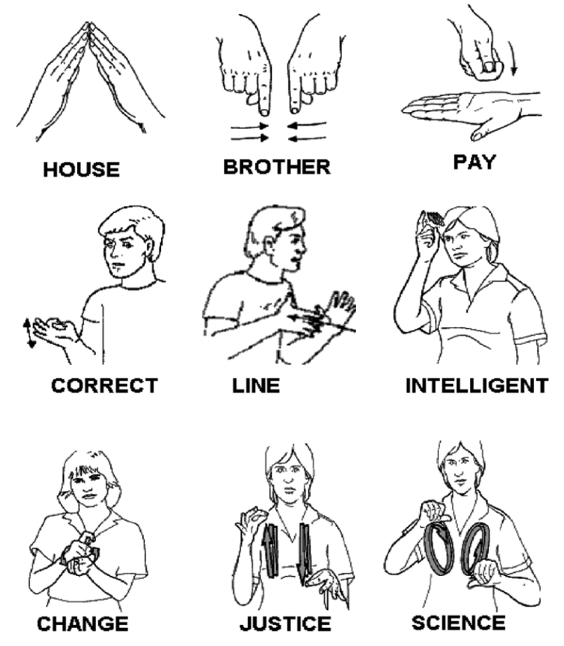
TECHNICAL APPROACH
Beta
Squad
Your Team Name
We Used the programming languages React js and node js for developing the App.
Mobile ,laptops,Tabs these are the hardwares we will use.

Slide 4
FEASIBILITY AND VIABILITY
Your Team Name
Beta
Squad
Interactive lessons
Sign Language Tutorials
Virtual Learning Environment
Personalized Learning Paths
Peer-to-Peer Learning
Teacher Support

Slide 5
IMPACT AND BENEFITS
Beta
Squad
Increased access to educational resources.
Improved communication with teachers.
Empowerment of deaf and mute students
Enhanced learning outcomes for deaf and mute students.

Slide 6
RESEARCH AND REFERENCES
Your Team Name
Beta
Squad
https://www.Britannica.com/topic/sign-language
National Geographic –Sign Language

Slide 7
IMPORTANT INSTRUCTIONS
Please ensure below pointers are met while submitting the Idea PPT:
Kindly keep the maximum slides limit up to six (6). ( Including the title slide)
Try to avoid paragraphs and post your idea in points /diagrams / Infographics /pictures
Keep your explanation precise and easy to understand
Idea should be unique and novel.
You can only use provided template for making the PPT without changing the idea details pointers (mentioned in previous slides).
You need to save the file in PDF and upload the same on portal. No PPT, Word Doc or any other format will be supported.
Note - You can delete this slide (Important Pointers) when you upload the details of your idea on SIH portal.

